Slide 1
Personality Test
Teamwork Meeting

Slide 2
Instructions
You have each been given a sheet of paper with pie charts on them. Each slide of this PowerPoint will have a statement on it. If you agree with that statement, color in a piece of the pie chart labeled the color that matches the background of the slide. At the end, whichever colored pie chart you colored in the most will determine what personality you are.

Slide 3
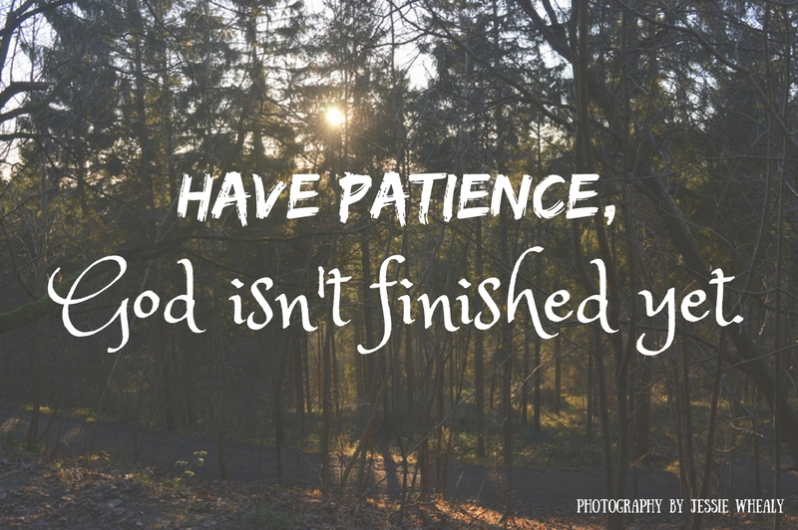
I am patient

Slide 4
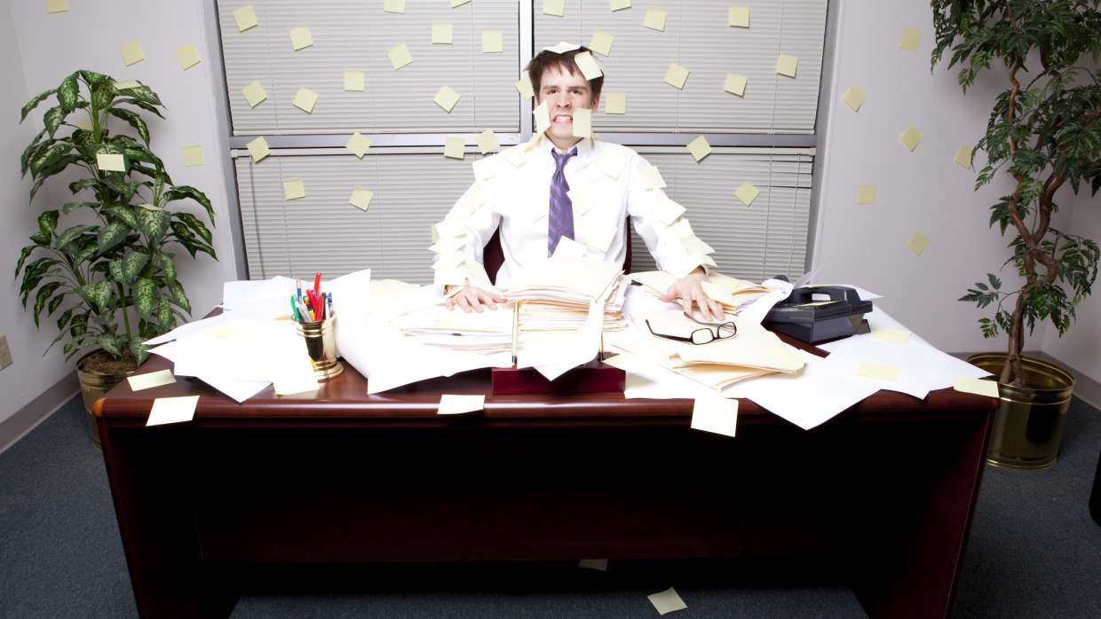
I tend to be unorganized

Slide 5
I like being a leader

Slide 6
I am a thoughtful person

Slide 7
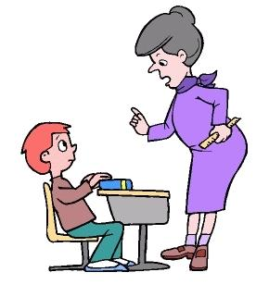
Teachers have said that I am too loud

Slide 8
I am a confident person

Slide 9
Sometimes I see the negatives before I see the positives

Slide 10
I generally get along with everyone

Slide 11
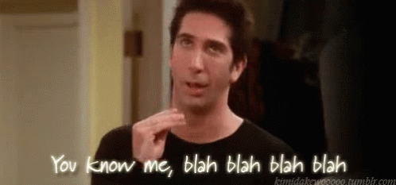
I like to talk

Slide 12
I over-analyze everything

Slide 13
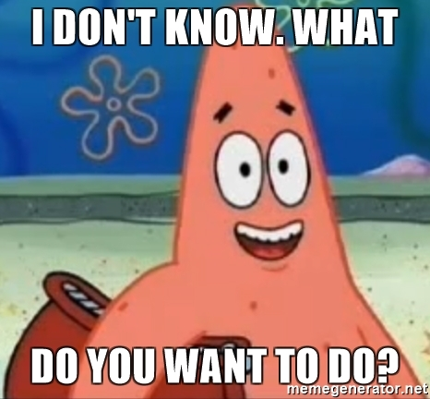
I don’t like making decisions

Slide 14
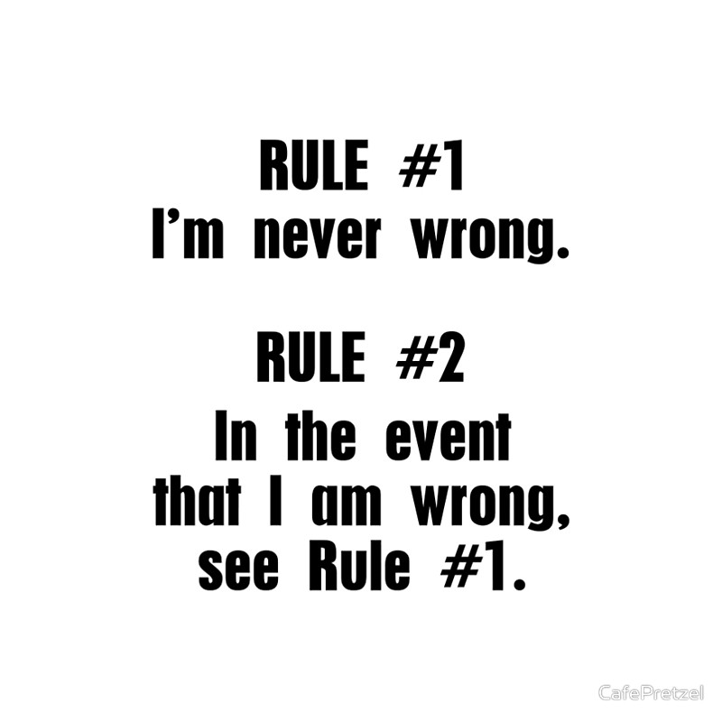
I don’t like to admit when I am wrong

Slide 15
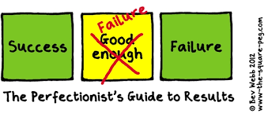
I am a perfectionist

Slide 16
Some people would say I am shy

Slide 17
I have a lot of good ideas but sometimes I don’t follow through with them

Slide 18
I like being a decision maker

Slide 19
I avoid conflict

Slide 20
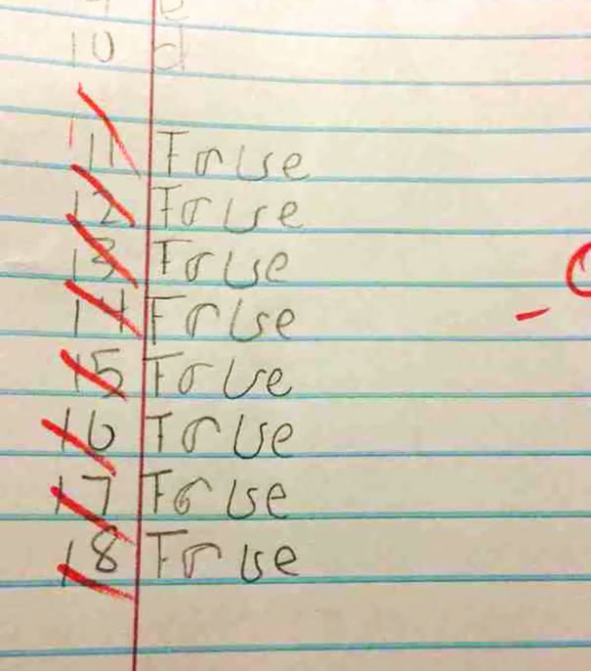
I don’t care if my answers are wrong as long as I got it done

Slide 21
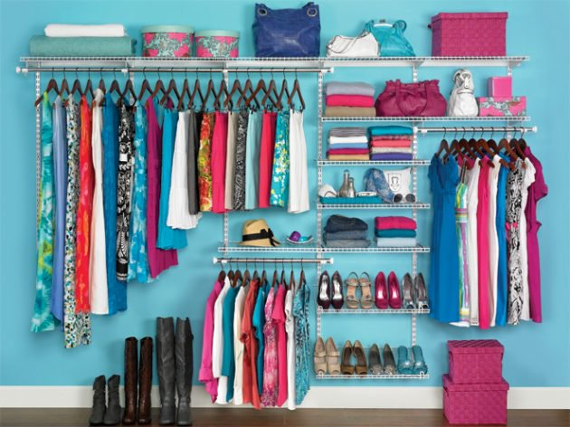
I like to be organized

Slide 22
I am outgoing

Slide 23
Sometimes I can be insensitive

Slide 24
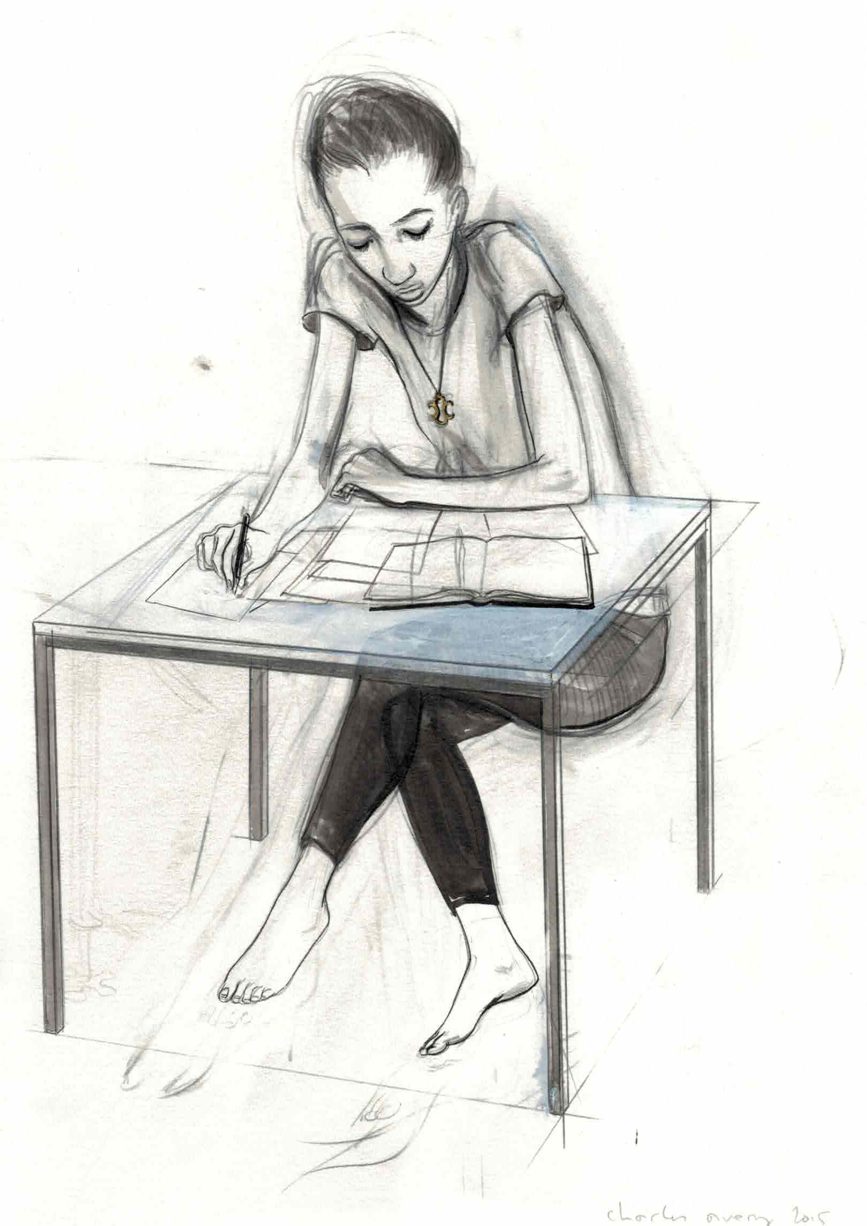
I am good at getting my homework done by myself

Slide 25
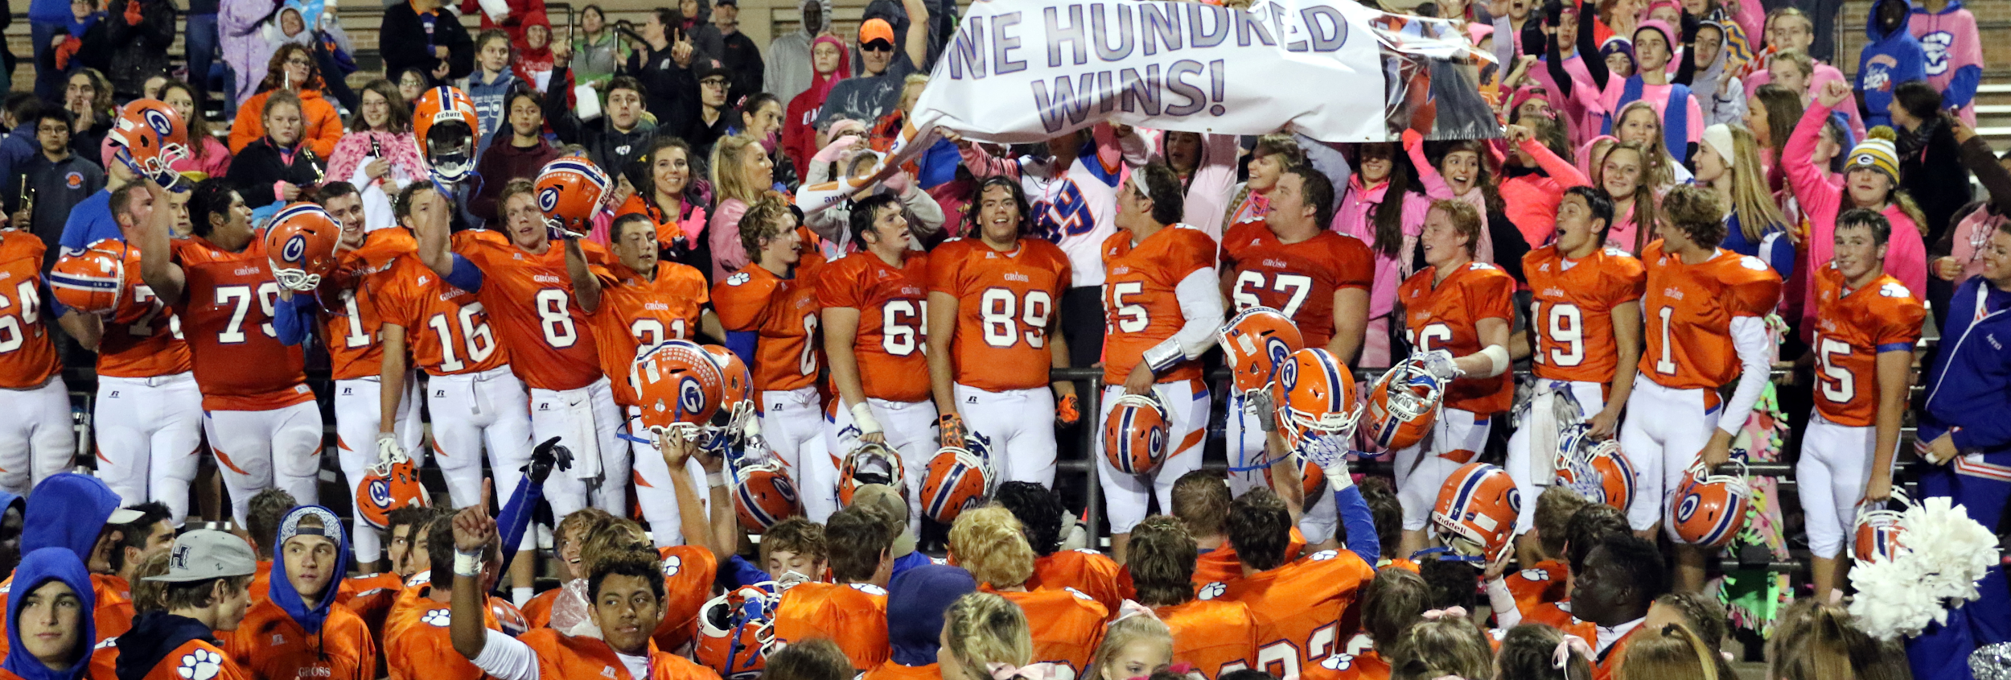
I like being a part of a team

Slide 26
I can be stubborn

Slide 27
Personality Types
Red: Driver
Confident
Leaders
Determined
Decision makers
Can be harsh and insensitive

Slide 28
Personality Types
Green: Analytical
Very deep and thoughtful
Perfectionists
Tend to have a dry, witty sense of humor
Neat and tidy
Can be moody and negative

Slide 29
Personality Types
Yellow: Amiable
Patient
Kind
Avoid conflict
Quiet but witty
Can be stubborn and selfish

Slide 30
Personality Types
Blue: Expressive
Prevent dull moments
Want to be included
Outgoing
Love to talk
Can be undisciplined and loud

